Slide 1

SUPER STORE SALES ANALYSIS
R3-Data Analyst Specialist CAI3_DAT1_G2 done by:
Nada Hany Mohamed Zaky
May Mahmoud Samy Abdelmeguid
Tarek essam
Nadeem Ashraf
Ahmed Mohamed Salem
Ahmed Ahmed Sharawy
Under supervision of:
Eng. Ahmed Samir
-

Slide 2

PROJECT OVERVIEW:
The Superstore Sales Analysis project involves the exploration and analysis of a sales dataset containing key transactional and customer information. The dataset includes details such as order ID, order date, shipping mode, customer and product identifiers, sales figures, and categorical breakdowns by product type and geographic region. The primary aim of this project is to generate actionable insights that can support data-driven decision-making in areas such as sales performance, customer behavior, and regional trends.

Slide 3
BACKGROUND:
Retail businesses generate vast amounts of transactional data that, when analyzed effectively, can uncover trends, inefficiencies, and growth opportunities. The Superstore Sales dataset simulates a mid-sized retail company’s historical sales data, capturing orders made by customers across various product categories and regions. Each entry records critical information, including order timelines, shipping methods, and sales values. This dataset provides a foundation for exploring key business metrics and evaluating the effectiveness of sales strategies, customer reach, and operational logistics.

Slide 4
OBJECTIVE:
The primary objectives of this project are to:
1. Analyze Sales Performance: Evaluate overall and segmented sales trends across categories, sub-categories, regions, and time periods.
2. Identify High-Value Customers and Products: Determine the most profitable customer segments and best-selling product categories.
3. Assess Shipping and Operational Efficiency: Explore the impact of different shipping modes on delivery timelines and sales outcomes.
4. Uncover Regional Insights: Compare sales distribution and customer behavior across different regions.
5. Support Strategic Planning: Provide data-driven recommendations to enhance sales strategies, inventory management, and customer targeting.

Slide 5

TOOLS AND TECHNIQUES USED:
Exploratory Data Analysis “EDA”, Normalization, CLEANING, Analysis and visualization
EXCEL
SQL
Python
Tableau

Slide 6
OUR DATASET CONSISTS OF:
9800 Rows
18 Columns
Total Sales: 2,261,536
Products No.: 1817
Orders No: 4922
Customers No.:793

Slide 7
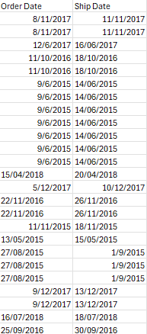
CHALLENGES IN OUR DATA SET:
First Challenge:
The date formats are inconsistent. For example, some records show dates as 4/1/2025, others as 1/4/2025, 4/01/2025, or 1/04/2025. These formats need to be standardized to avoid confusion and ensure uniformity across the dataset and its data type should be changed to be Date.

Slide 8
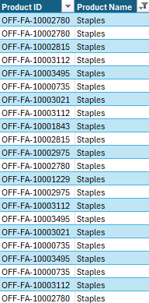
CHALLENGES IN OUR DATA SET:
Second Challenge:
The same product is assigned multiple IDs, and conversely, the same ID is sometimes linked to different products. This inconsistency needs to be resolved to ensure accurate mapping and analysis.”

Slide 9
CHALLENGES IN OUR DATA SET:
Third Challenge:
One of the challenges in our dataset is that it lacks the product cost price, which prevents us from calculating the profit accurately. Additionally, the dataset does not include information on the quantity or amount of returned orders, which limits our ability to analyze order returns.

Slide 10
HOW WE HANDELED THESE CHALLENGES:
We handeled the standardization of the date formate in the cleaning process.
We handeled the problem of product id by using Power Query for data cleaning.

Slide 11
TOOL NO.1: MICROSOFT EXCEL
Data Preparation and Analysis Workflow
1. Data Unification
·Objective: Ensure consistency and integrity across product-related data.
·Process:
oStandardized and unified Product IDs for each corresponding Product Name to maintain consistent identification across datasets.
oResolved discrepancies and ensured all products were correctly mapped to their respective IDs.

Slide 12
2. Data Normalization
Objective: Eliminate data redundancy and improve database efficiency.
Process:
Applied First Normal Form (1NF) by removing repeating groups and ensuring each column contains atomic values.
Applied Second Normal Form (2NF) by removing partial dependencies—each non-key attribute depends on the whole primary key.
Applied Third Normal Form (3NF) by removing transitive dependencies—ensuring non-key attributes depend only on the primary key.
Result: The large, unstructured table was decomposed into four related tables:
Products
Customers
Orders
Sales

Slide 13
3. Data Cleaning
·Objective: Ensure data accuracy and consistency before modeling.
·Process:
oUsed Power Query to identify and remove duplicate records from each table.
oValidated data integrity and verified uniqueness of key fields.
4. Data Modeling
·Objective: Establish logical relationships for analysis.
·Process:
oDefined Primary Keys (unique identifiers) for each table.
oCreated Foreign Key relationships between tables (e.g., linking Orders to Customers and Products).
oBuilt a relational data model to enable efficient querying and reporting.

Slide 14
5. Data Analysis and Visualization
·Objective: Derive business insights from the prepared data.
·Process:
oUtilized Pivot Tables in Excel to analyze sales performance, customer behavior, and product trends.
oDeveloped interactive summaries and key performance metrics to support decision-making.

Slide 15
TOOL NO.2: SQL
Creating Database:
·Database was created named “SuperStoreSales”
·Then 4 tables were created (Customer -Product- Order- Details) with their columns and Data type in each column
Inserting The data:
·We tried Microsoft Access at first, but it didn’t work
·So instead, we saved each sheet in the workbook as .CSV file so we were left by 4 .CSV files one for each table because it can’t save the whole workbook at a time
·Then we used Bulk insert to insert all the data.

Slide 16
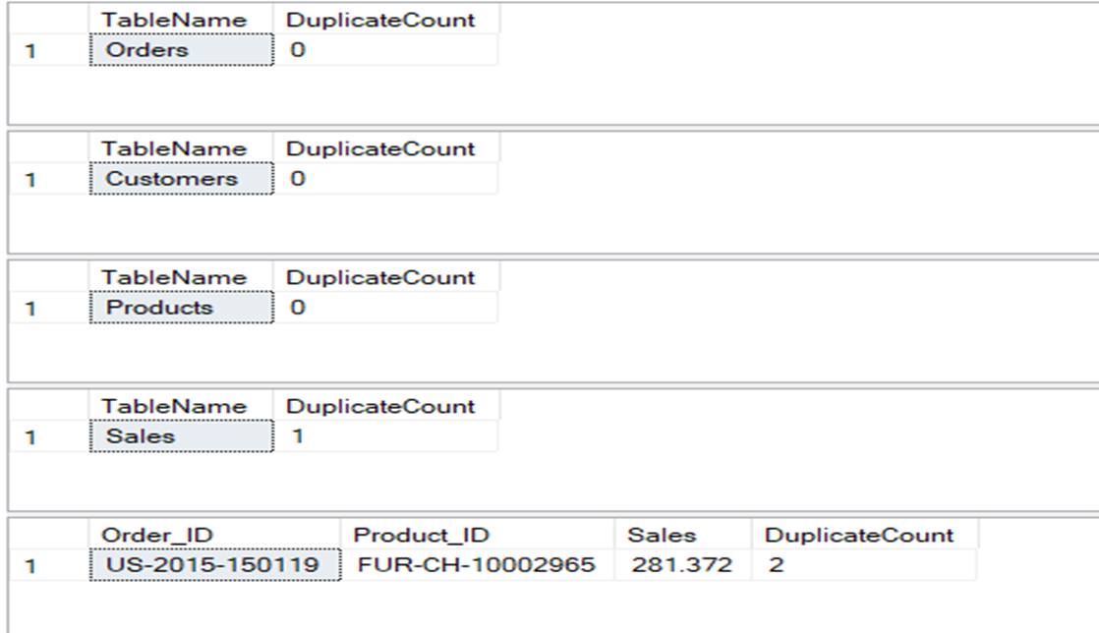
Data Cleaning:
We checked the data for duplicates; All tables were duplicates free except for Sales table one duplicate was found of Order_ID “US-2015-150119” and Product_ID “FUR-CH-10002965”

Slide 17
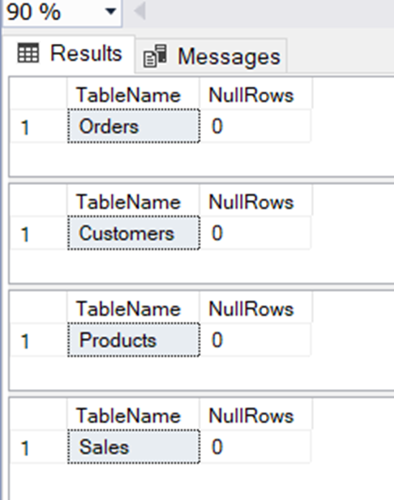
·So, we dropped that duplicate using the syntax Delete and now our data is Duplicates-Free.
·We checked our Data for Nulls, and no Nulls were found.

Slide 18
·Then, we were Trying To unify the format of the Order Date and Ship date and there were two problems. First, Dates are written by more Than one format. Second, After saving Our files as .CSV , It changed all the data as a text so SQL is reading it right now as a text and Not a date and If we changed the Data type to Date it will give as inaccurate data full of Nulls because Dates are written by more than one format besides SQL only reads the ISO 8601 format YYYY-MM-DD.
·So, we approached by Unifying the text format, then splitting The Text into Day, Month and Year columns, then adding a customized column that calculate the date by merging the three other columns of Day, Month and Year and we did so for both Order Date and Ship Date.

Slide 19
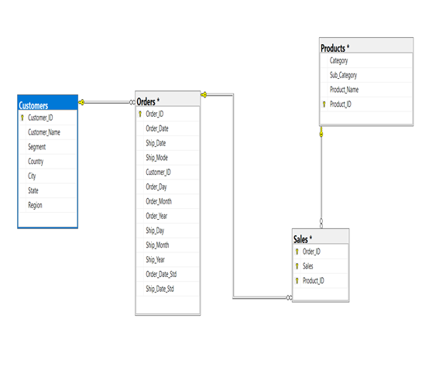
Creating Relationship between Tables:
·We created the relationship between the 4 tables by using the relationship diagram as shown:
-In Customers table Customer_ID is the primary key.
-In Orders table Order_ID is the primary key and Customer_ID is the foreign key.
-In Products table Product_ID is the primary key.
-In Sales table Order_ID,Product_ID and Sales are the Primary Key (Composite Key).

Slide 20
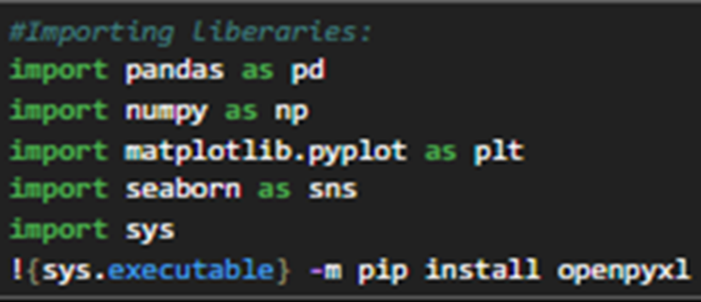
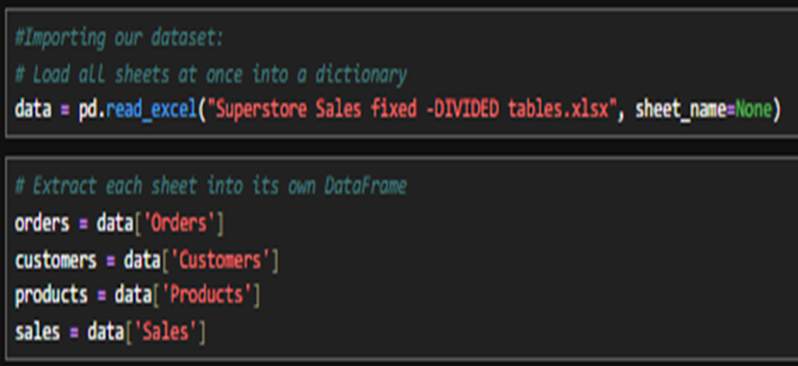
TOOL NO.3: PYTHON
Importing the Required Libraries:
We start by importing the necessary Python libraries for data manipulation and analysis (Pandas-Numpy-sys-…).
·We imported our dataset and extracted each sheet from the workbook

Slide 21
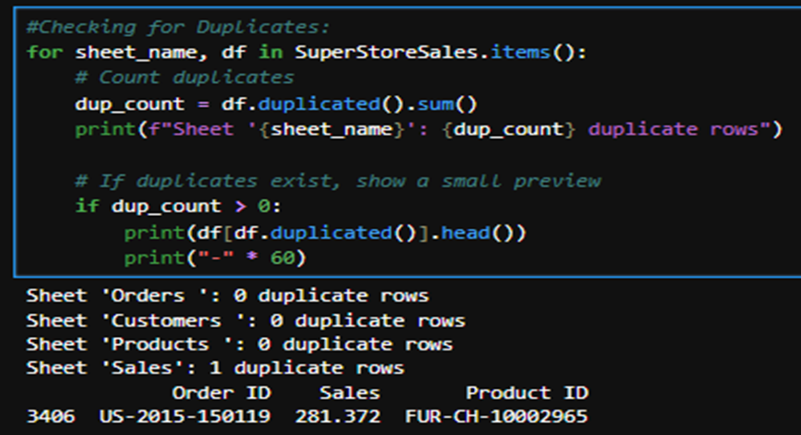
Then, we started our cleaning:
First, we checked our Data for duplicates only one duplicate was found in our data in the sales table it was order with Order ID: US-2015-150119 and Product ID FUR-CH-10002965.

Slide 22
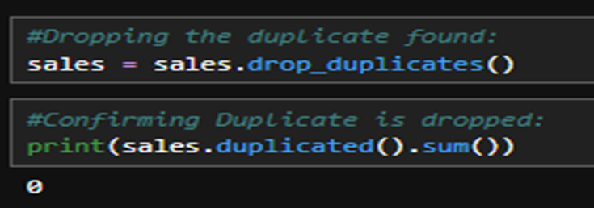
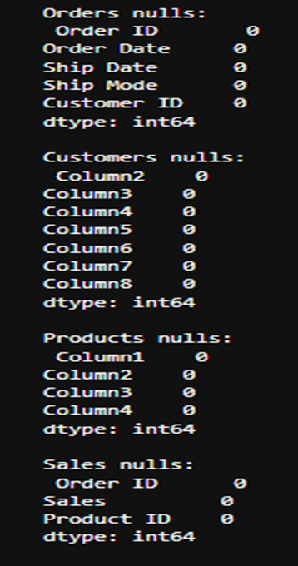
Then, we dropped that duplicate, and we verified that our data is duplicate-free.
•Then We checked our data for Nulls, and no Nulls were found.

Slide 23
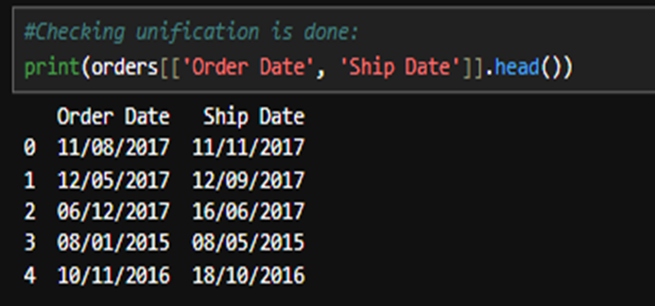
Then, we started the unification of the dates format in the Ship Date and Order Date columns.
Then we started Creating Relationship between Tables:
·We created the relationship between the 4 tables by using the relationship diagram as shown:
-In Customers table Customer_ID is the primary key.
-In Orders table Order_ID is the primary key and Customer_ID is the foreign key.
-In Products table Product_ID is the primary key.
-In Sales table Order_ID,Product_ID and Sales are the Primary Key (Composite Key).

Slide 24
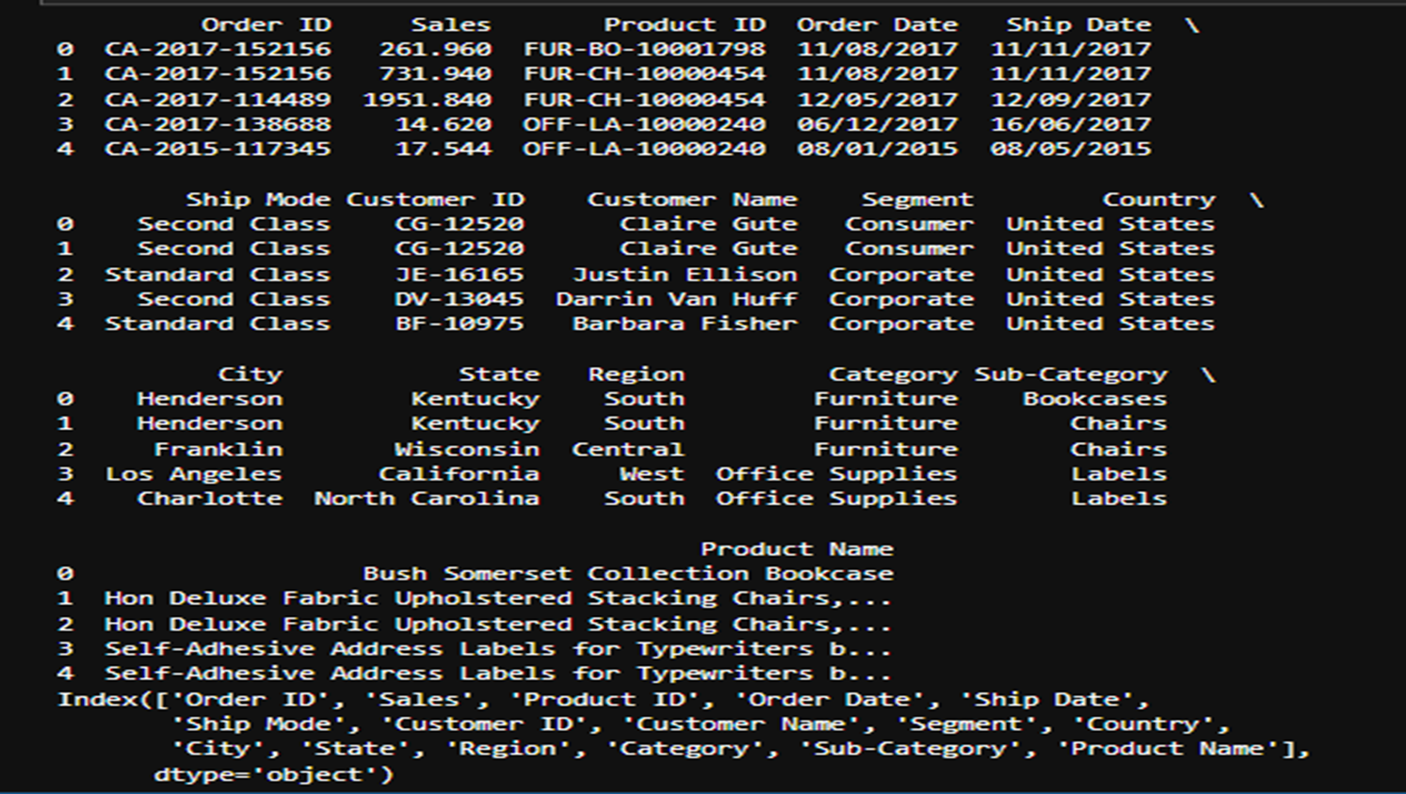

Slide 25
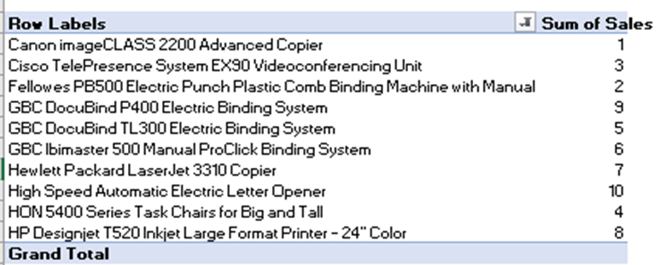
THEN WE STARTED OUR ANALYSIS THEN VISUALIZATION VIA TABLEAU
1- What are the top 10 best-selling products?

Slide 26
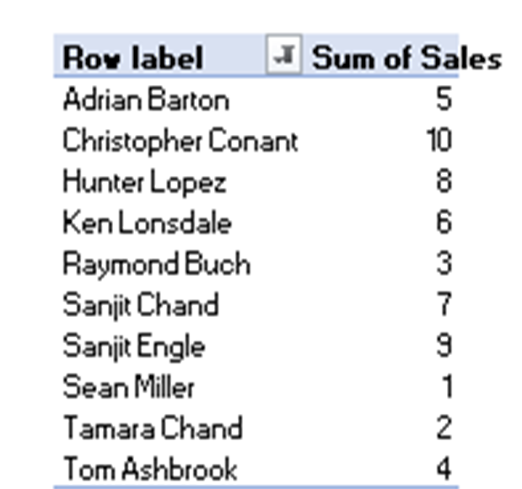
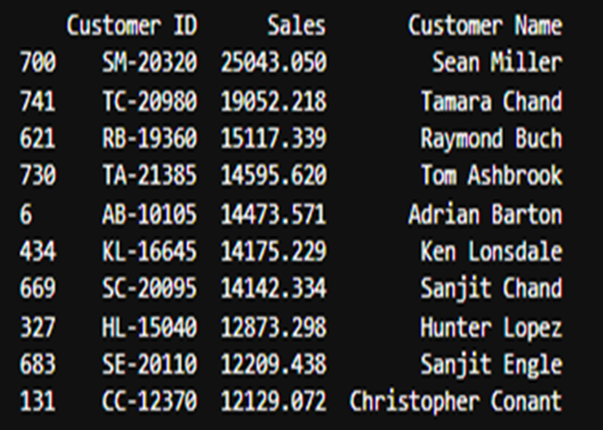
2. Who are the top 10 customers in terms of total revenue?

Slide 27
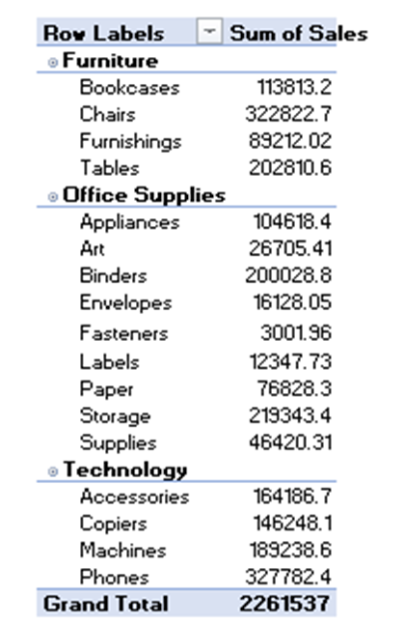
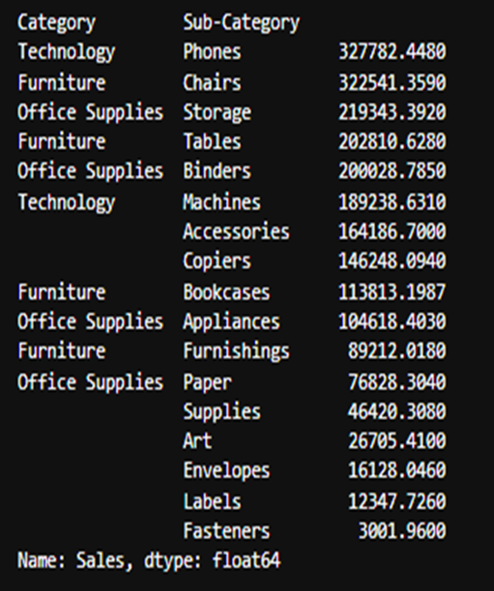
3- Which product categories and sub-categories generate the highest sales?

Slide 28
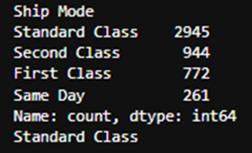
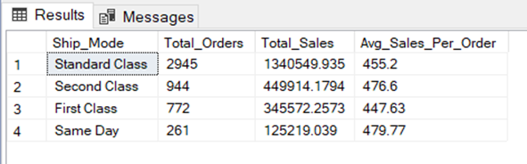
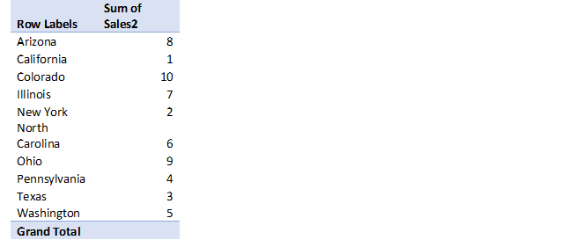
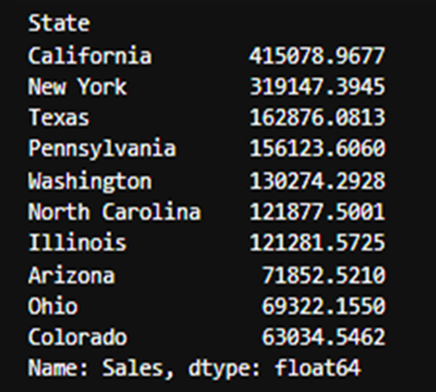
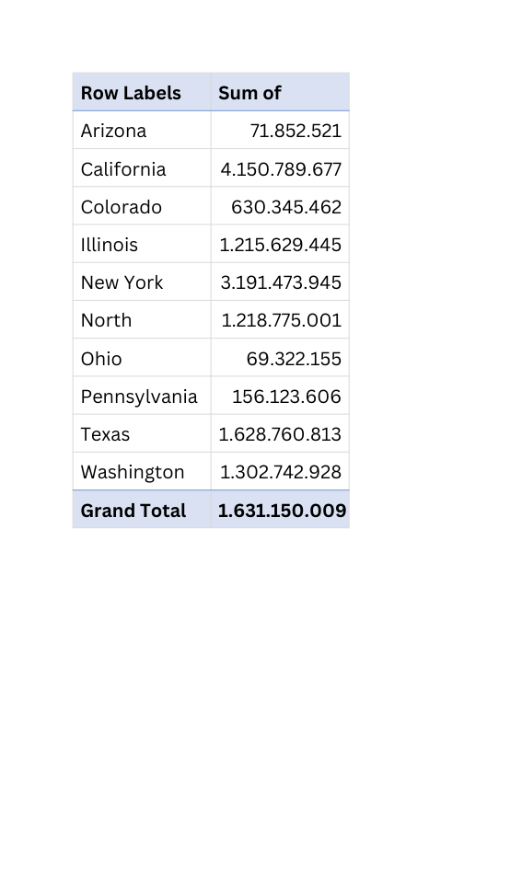
4. Most shipment mode used
5.Top 10 Sales states

Slide 29
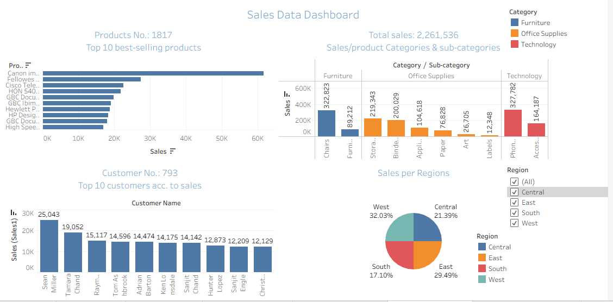

Slide 30
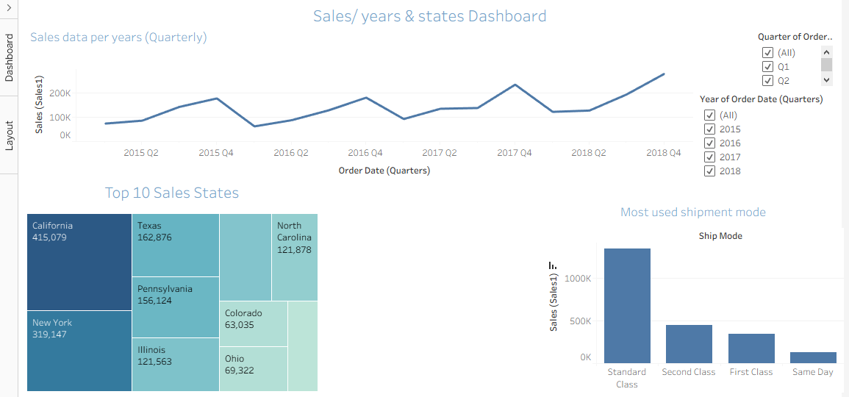

Slide 31
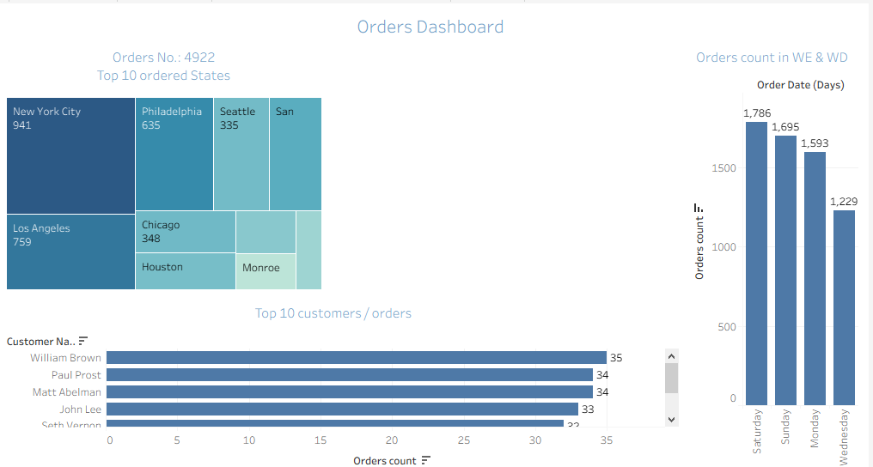

Slide 32

Recommendations to Increase Sales
1-Faster delivery can improve customer satisfaction and encourage repeat purchases.
Reduce Shipping Time
Aim to decrease the average shipping time to less than 4 days, especially for frequently used
shipping methods such as Standard Shipping.
2-Invest in High-Performing Products
Increase stock and marketing efforts for top-selling products, particularly those in
the Technology category.
Consider expanding offerings in the Furniture category, which recorded the fastest sales growth.

Slide 33
Recommendations to Increase Sales
3-Focus on High-Purchasing Regions
- Allocate more resources to areas with higher purchase frequency, such as:
California
New York
Philadelphia
- Use targeted advertising and localized promotions.
- Implement a Customer Retention Program
4-Encourage repeat purchases by introducing:
Loyalty or rewards programs
Exclusive discounts for returning customers
Personalized recommendations
-Objective: Increase the average number of orders per customer to more than one per year.

Slide 34

For better future analysis:
To enable more accurate and insightful future analyses, it is recommended to enhance data quality by:
Including Product Cost Data
Collect cost price information to calculate profit, not only revenue.
This will help identify the most profitable products, not just the best-selling ones.
Tracking Order Returns
Add data on the quantity and value of returned orders.
This will improve the accuracy of identifying:
The real top-performing regions, based on net sales (after returns).
The true best-performing products, considering return rates.
Standardizing Data Entry
Ensure consistent formats (e.g., date formats, product IDs) to enhance reliability and facilitate deeper analysis.

Slide 35

THANK YOU

